Slide 1
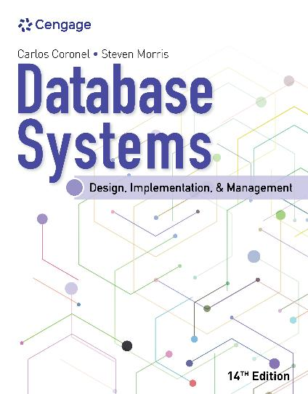
Database Systems: Design, Implementation, and Management, 14e
Module 1: Database Systems
Coronel, Carlos and Morris, Steven, Database Systems: Design, Implementation, and Management, 14 Edition. © 2023 Cengage. All Rights Reserved. May not be scanned, copied or duplicated, or posted to a publicly accessible website, in whole or in part.

Slide 2
Icebreaker: Interview Simulation
The class will be broken up into pairs of students.
Each pair of students will interview each other to discover interesting or unusual facts
Then each pair will introduce each other to the class.
Think about connecting a story from your personal experiences to topics that are relevant to this course.

Slide 3
Chapter Objectives (1 of 2)
By the end of this chapter, you should be able to:
Define the difference between data and information
Describe what a database is, the various types of databases, and why they are valuable assets for decision making
Explain the importance of database design
See how modern databases evolved from file systems

Slide 4
Chapter Objectives (2 of 2)
By the end of this chapter, you should be able to (continued):
Understand flaws in file system data management
Outline the main components of the database system
Describe the main functions of a database management system (DBMS)

Slide 5
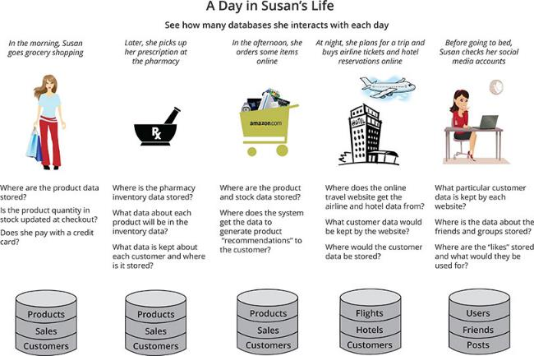
Why Databases?
Figure 1.1 The Pervasive Nature of Databases

Slide 6
Data versus Information (1 of 2)
Data consists of raw facts
The facts have not yet processed to reveal meaning to the end user
Information is the result of processing raw data to reveal the meaning of data
To reveal meaning, information requires context
Data is the foundation of information, which is the bedrock of knowledge
Knowledge implies familiarity, awareness, and understanding of information
Accurate, relevant, and timely information is the key to good decision making
Data management is a discipline that focuses on the proper generation, storage, and retrieval of data

Slide 7
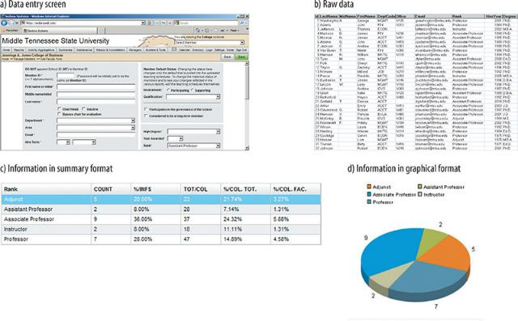
Data versus Information (2 of 2)
Figure 1.2 Transforming Raw Data into Information

Slide 8
Introducing the Database
A database is a shared, integrated computer structure that stores a collection of the following:
End-user data – that is, raw facts of interest to the end user
Metadata, or data about data, through which the end-user data is integrated and managed
Metadata describes the data characteristics and the set of relationships that links the data found within the database
A database management system (DBMS) is a collection of programs that manages the database structure and controls access to the data stored in the database

Slide 9
Role and Advantages of DBMS (1 of 2)
The DBMS presents the end user with a single, integrated view of the data in the database
A DBMS provides the following advantages:
Improved data sharing
Improved data security
Better data integration
Minimized data inconsistency
Improved data access
Improved decision making
Increased end-user productivity

Slide 10
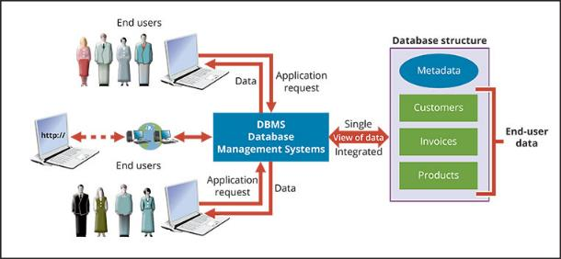
Role and Advantages of DBMS (2 of 2)
Figure 1.4 The DBMS Manages the Interaction Between the End User and the Database

Slide 11
Types of Databases (1 of 4)
A single-user database supports one user at a time
A desktop database is single-user database on a personal computer
A multiuser database supports multiple users at the same time
A workgroup database supports a small number of users or a specific department
An enterprise database supports many users across many departments
Classification by location
A centralized database supports data located at a single site
A distributed database supports data distributed across different sites
A cloud database is created and maintained using cloud data services

Slide 12
Types of Databases (2 of 4)
Classification by data type
General-purpose databases contain a wide variety of data used in multiple disciplines
Discipline-specific databases contain data focused on specific subject areas
An operational database is designed to support a company’s day-to-day operations
An analytical database stores historical data and business metrics used exclusively for tactical or strategic decision making and is comprised of two main components:
The data warehouse stores data in a format optimized for decision support
Online analytical processing (OLAP) is a set of tools for retrieving, processing, and modeling data from the data warehouse

Slide 13
Types of Databases (3 of 4)
Business intelligence describes a comprehensive approach to capture and process business data to generate information that support decision making
Databases can be classified to reflect the degree to which the data is structured
Unstructured data exists in its original (raw) state
Structured data is the result of formatting unstructured data to facilitate storage and use
Semistructured data has already been processed to some extent
Extensible Markup Language (XML) is a language used to represent data elements in textual format
An XML database supports the storage and management of unstructured XML data

Slide 14
Types of Databases (4 of 4)
Social media refers to web and mobile technologies that enable “anywhere, anytime, always on” human interaction
Data is captured about end users and consumers that requires the use of specialized database systems
The term NoSQL (Not only SQL) is a new generation of DBMS that is not based on the traditional relational database model
These databases are designed to handle an unprecedented volume of data, variety of data types and structures, and velocity of data operations of new business requirements

Slide 15
Knowledge Check Activity 1-1
What is a DBMS?

Slide 16
Knowledge Check Activity 1-1: Answer
What is a DBMS?
Answer: A DBMS is best described as a collection of programs that manage the database structure and that control shared access to the data in the database. Current DBMSs also store the relationships between the database components; they also take care of defining the required access paths to those components.

Slide 17
Why Database Design is Important (1 of 3)
Database design refers to the activities that focus on the design of the database structure that will be used to store and manage end-user data
Designing appropriate data repositories of integrated information using the two-dimensional table structures found in most databases is a process of decomposition
The integrated data must be decomposed properly into its constituent parts
A well-designed database facilitates data management and generates accurate and valuable information
A poorly designed database causes difficult-to-trace errors that may lead to poor decision making

Slide 18
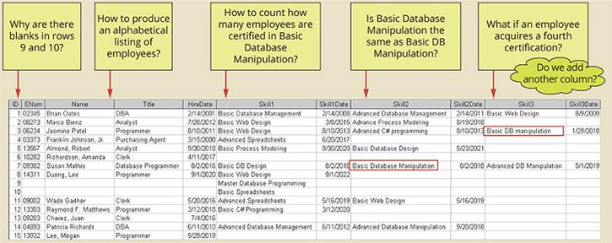
Why Database Design is Important (2 of 3)
Figure 1.5 Employee Skills Certification in a Poor Design

Slide 19
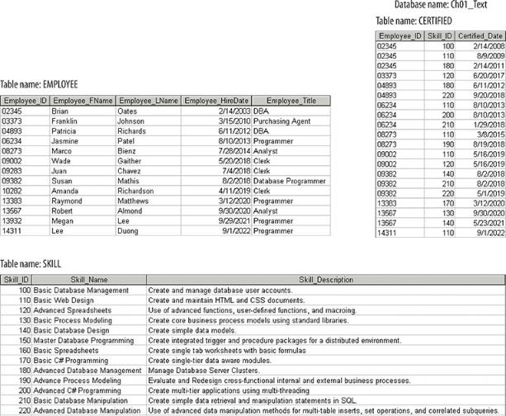
Why Database Design is Important (3 of 3)
Figure 1.6 Employee Skills Certification in a Good Design

Slide 20
Evolution of File System Data Processing (1 of 2)
Manual file systems are accomplished through a system of file folders and filing cabinets
With computerized file systems, a data processing (DP) specialist created a computer-based system to track data and produce required reports
File System Redux: Modern End-User Productivity Tools
Business users widely use spreadsheet programs such as Microsoft Excel to enter data in a series of rows and columns to manipulate data
A common misuse of spreadsheets is as a substitute for a database

Slide 21
Evolution of File System Data Processing (2 of 2)
Table 1.2 | Basic File Terminology
Term | Definition
Data | Raw facts, such as a telephone number, a birth date, a customer name, and a year-to-date (YTD) sales value. Data has little meaning unless it has been organized in some logical manner.
Field | A character or group of characters (alphabetic or numeric) that has a specific meaning. A field is used to define and store date.
Record | A logically connected set of one or more fields that describes a person, place, or thing. For example the fields that constitute a record for a customer might consist of the customer’s name, address, phone number, date of birth, credit limit, and unpaid balance.
File | A collection of related records. For example, a file might contain data about the students currently enrolled at Gigantic University.

Slide 22
Problems with File System Data Processing
The following problems with file systems challenge the types of information that can be created from data as well as information accuracy:
Lengthy development times
Difficulty of getting quick answers
Complex system administration
Lack of security and limited data sharing
Extensive programming

Slide 23
Structural and Data Dependence (1 of 2)
A file system exhibits structural dependence, which means that access to a file is dependent on its own structure
All file system programs are modified to conform to a new file structure
Structural independence exists when you change the file structure without affecting the application’s ability to access the data
Data dependence exists when all data access programs are subject to change when data storage characteristics change
Data independence exists when data storage characteristics are changed without affecting the program’s ability to access the data

Slide 24
Structural and Data Dependence (2 of 2)
The practical significance of data dependence is the difference between the logical data format (how humans view the data) and the physical data format (how the computer must work with the data)
Any program that accesses a file system’s file must tell the computer not only what to do but also how to do it
Data dependence makes the file system cumbersome from the point of view of a programmer and database manager

Slide 25
Data Redundancy
Data redundancy exists when the same data is stored unnecessarily at different places
Database professionals use the term islands of information for scattered data locations
Increases the probability of having different versions of the same data
Possible results of uncontrolled data redundancy
Poor data security
Data inconsistency
Data-entry errors
Data integrity problems

Slide 26
Data Anomalies
A data anomaly develops when not all of the required changes in the redundant data are made successfully
The following are three types of anomalies:
Update anomalies
Insertion anomalies
Deletion anomalies

Slide 27
Knowledge Check Activity 1-2
What is data redundancy, and which characteristics of the file system can lead to it?

Slide 28
Knowledge Check Activity 1-2: Answer
What is data redundancy, and which characteristics of the file system can lead to it?
Answer: Data redundancy exists when unnecessarily duplicated data are found in the database. For example, a customer's telephone number may be found in the customer file, in the sales agent file, and in the invoice file. Data redundancy is symptomatic of a (computer) file system, given its inability to represent and manage data relationships. Data redundancy may also be the result of poorly‑designed databases that allow the same data to be kept in different locations.

Slide 29
Database Systems (1 of 2)
The database system consists of logically related data stored in a single logical data repository
However, the data might be physically distributed among multiple storage facilities
The database’s DBMS eliminates most of the file system’s data inconsistency, data anomaly, data dependence, and structural dependence problems
The current generation of DBMS software stores data structures, relationships between those structures, and access paths to those structures
The current generation also defines, stores, and manages all access paths and components

Slide 30
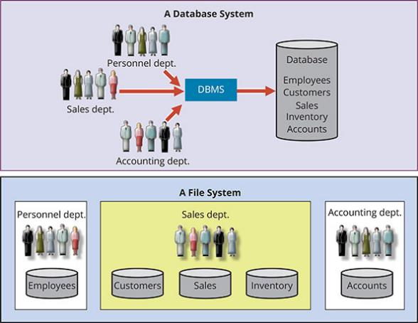
Database Systems (2 of 2)
Figure 1.9 Contrasting Database and File Systems

Slide 31
The Database System Environment (1 of 2)
The term database system refers to an organization of components that define and regulate the collection, storage, management, and use of data within a database environment
The database system is composed of the following five components:
Hardware
Software
People
Procedures
Data
Database solutions must be cost-effective as well as tactically and strategically effective

Slide 32
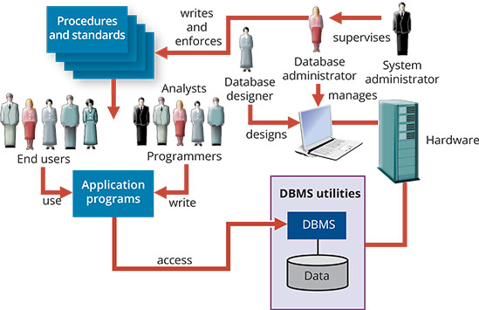
The Database System Environment (2 of 2)
Figure 1.10 The Database System Environment

Slide 33
DBMS Functions (1 of 3)
A DBMS performs the following important functions:
Data dictionary management – The DBMS stores definitions of data elements and their relationships in a data dictionary
Data storage management – The DBMS creates and manages the structures required for data storage
Performance tuning ensures efficient performance
Data transformation and presentation – The DBMS transforms entered data to conform to required data structures
Data is formatted to conform to the user’s logical expectations
Security management – The DBMS creates a system that enforces user security and data privacy

Slide 34
DBMS Functions (2 of 3)
A DBMS performs the following important functions (continued):
Multiuser access control – The DBMS uses sophisticated algorithms to ensure that multiple users can access the database concurrently without compromising its integrity
Backup and recovery management – The DBMS provides backup and data recovery to ensure data safety and integrity
Recovery management deals with the recovery of the database after a failure
Data integrity management – The DBMS promotes and enforces integrity rules, thus minimizing redundancy and maximizing data consistency

Slide 35
DBMS Functions (3 of 3)
A DBMS performs the following important functions (continued):
Database access languages and application programming interfaces – The DBMS provides data access through a query language
A query language lets the user specify what must be done without having to specify how
Structured Query Language (SQL) is the de facto query language and data access standard supported by the majority of DBMS vendors
Database communication interfaces – A DBMS accepts end-user requests via multiple communication interfaces

Slide 36
Managing the Database System: A Shift in Focus
Disadvantages of database systems include the following:
Increased costs
Management complexity
Maintaining currency
Vendor dependence
Frequent upgrade/replacement cycles

Slide 37
Preparing for Your Database Professional Career
Table 1.3 | Database Career Opportunities
Job Title | Description | Sample Skills Required
Database Developer | Create and maintain database-based applications | Programming, database fundamentals, SQL
Database Designer | Design and maintain databases | Systems design, database design, SQL
Database Administrator | Manage and maintain DBMS and databases | Database fundamentals, SQL, vendor courses
Database Analyst | Develop databases for decision support reporting | SQL, query optimization, data warehouses
Database Architect | Design and implementation of database environments (conceptual, logical, and physical) | DBMS fundamentals, data modeling, SQL, hardware knowledge, etc.
Database Consultant | Help companies leverage database technologies to improve business processes and achieve specific goals | Database fundamentals, data modeling, database design, SQL, DBMS, hardware, vendor-specific technologies, etc.
Database Security Officer | Implement security policies for data administration | DBMS fundamentals, database administration, SQL, data security technologies, etc.
Cloud Computing Data Architect | Design and implement the infrastructure for next-generation cloud database systems | Internet technologies, cloud storage technologies, data security, performance tuning, large databases, etc.
Data Scientist | Analyze large amounts of varied data to generate insights, relationships, and predictable behaviors | Data analysis, statistics, advanced mathematics, SQL, programming, data mining, machine learning, data visualization

Slide 38
Knowledge Check Activity 1-3
What are the main components of a database system?

Slide 39
Knowledge Check Activity 1-3: Answer
What are the main components of a database system?
Answer: The basis of this discussion is Section 1-7a, THE DATABASE SYSTEM ENVIRONMENT. Figure 1.10 provides a good bird’s eye view of the components. Note that the system’s components are hardware, software, people, procedures, and data.

Slide 40
Summary (1 of 2)
Now that the lesson has ended, you should be able to:
Define the difference between data and information
Describe what a database is, the various types of databases, and why they are valuable assets for decision making
Explain the importance of database design
See how modern databases evolved from file systems

Slide 41
Summary (2 of 2)
Now that the lesson has ended, you should be able to (continued):
Understand flaws in file system data management
Outline the main components of the database system
Describe the main functions of a database management system (DBMS)

